Slide 1
Implementing Parent & Child Process to do a task

Slide 2
1. Write a program to find sum of even numbers in parent process and sum of odd numbers in child process.
// C++ program to demonstrate calculation in parent and
// child processes using fork()
#include <iostream>
#include <unistd.h>
using namespace std;
// Driver code
int main()
{
int a[10] = { 1, 2, 3, 4, 5, 6, 7, 8, 9, 10 };
int sumOdd = 0, sumEven = 0, n, i;
n = fork();
// Checking if n is not 0
if (n > 0) {
for (i = 0; i < 10; i++) {
if (a[i] % 2 == 0)
sumEven = sumEven + a[i];
}

Slide 3
cout << "Parent process \n";
cout << "Sum of even no. is " << sumEven << endl;
}
// If n is 0 i.e. we are in child process
else {
for (i = 0; i < 10; i++) {
if (a[i] % 2 != 0)
sumOdd = sumOdd + a[i];
}
cout << "Child process \n";
cout << "\nSum of odd no. is " << sumOdd << endl;
}
return 0;
}
Output:
Parent process
Sum of even no. is 30
Child process
Sum of odd no. is 25

Slide 4
2. Implement the C program to accept n integers to be sorted. Main function creates child
process using fork system call. Parent process sorts the integers using bubble sort and waits for child process using wait system call. Child process sorts the integers using insertion sort.
#include<stdio.h>
#include<sys/types.h>
#include<unistd.h>
#include<stdlib.h>
void bubblesort(int arr[30],int n)
{
int i,j,temp;
for(i=0;i<n;i++)
{
for(j=0;j<n-1;j++)
{
if(arr[j]>arr[j+1])
{
temp=arr[j];
arr[j]=arr[j+1];
arr[j+1]=temp;
} } }}

Slide 5
void fork1()
{
int arr[25],arr1[25],n,i,status;
printf("\nEnter the no of values in array :");
scanf("%d",&n);
printf("\nEnter the array elements :");
for(i=0;i<n;i++)
scanf("%d",&arr[i]);
int pid=fork();
if(pid==0)
{
sleep(10);
printf("\nchild process\n");
printf("child process id=%d\n",getpid());
insertionsort(arr,n);
printf("\nElements Sorted Using insertionsort:");
printf("\n");
for(i=0;i<n;i++)
printf("%d,",arr[i]);
printf("\b");
printf("\nparent process id=%d\n",getppid());
system("ps -x");
void insertionsort(int arr[30], int n)
{
int i, j, temp;
for (i = 1; i < n; i++) {
temp = arr[i];
j = i - 1;
while(j>=0 && temp <= arr[j])
{
arr[j+1] = arr[j];
j = j-1;
}
arr[j+1] = temp;
}
}

Slide 6
}
else
{
printf("\nparent process\n");
printf("\nparent process id=%d\n",getppid());
bubblesort(arr,n);
printf("Elements Sorted Using bubblesort:");
printf("\n");
for(i=0;i<n;i++)
printf("%d,",arr[i]);
printf("\n\n\n");
}
}
int main()
{
fork1();
return 0;
}
Output :
@kali-linux:~/Desktop/Ty$ cc qb1.c
@kali-linux:~/Desktop/Ty$ ./a.out
Enter the no of values in array :5
Enter the array elements :2 3 4 1 6
parent process
parent process id=3610
Elements Sorted Using bubblesort:
1,2,3,4,6,

Slide 7
//Q. Program to send a message from parent process to child process using pipe()
#include<stdio.h>
#include<unistd.h>
#include<sys/types.h>
#include<sys/wait.h>
int main()
{
int fd[2],n;
char buffer[100];
pid_t p; pipe(fd); //creates a unidirectional pipe with two end fd[0] and fd[1]
p=fork(); if(p>0) //parent
{
printf("Parent Passing value to child\n");
write(fd[1],"hello\n",6); //fd[1] is the write end of the pipe
wait();
}else // child
{printf("Child printing received value\n");
n=read(fd[0],buffer,100); //fd[0] is the read end of the pipe
write(1,buffer,n);
}
}

Slide 8
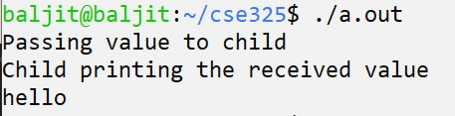
How it works?
The parent process create a pipe using pipe(fd) call and then creates a child process using fork(). Then the parent sends the data by writing to the writing end of the pipe by using the fd[1] file descriptor. The child then reads this using the fd[0] file descriptor and stores it in buffer. Then the child prints the received data from the buffer onto the screen.

Slide 9
write two programs for IPC using shared memory as an example. Program 1 will create the shared segment, attach it, and then write some content in it. Then Program 2 will attach itself to the shared segment and read the value written by Program 1.
Program 1: This program creates a shared memory segment, attaches itself to it, and then writes some content into the shared memory segment.
#include<stdio.h>
#include<stdlib.h>
#include<unistd.h>
#include<sys/shm.h>
#include<string.h>
int main()
{
int i;
void *shared_memory;
char buff[100];
int shmid;
shmid=shmget((key_t)2345, 1024, 0666|IPC_CREAT);

Slide 10
//creates shared memory segment with key 2345, having size 1024 bytes. IPC_CREAT is used to create the shared segment if it does not exist. 0666 are the permissions on the shared segment
printf("Key of shared memory is %d\n",shmid);
shared_memory=shmat(shmid,NULL,0);
//process attached to shared memory segment
printf("Process attached at %p\n",shared_memory);
//this prints the address where the segment is attached with this process
printf("Enter some data to write to shared memory\n");
read(0,buff,100); //get some input from user
strcpy(shared_memory,buff); //data written to shared memory
printf("You wrote : %s\n",(char *)shared_memory);
}
Output
Key of shared memory is 0
Process attached at 0x7ffe040fb000
Enter some data to write to shared memory
Hello World
You wrote: Hello World

Slide 11
Program 2: This program attaches itself to the shared memory segment created in Program 1, and it reads the content of the shared memory.
#include<stdio.h>
#include<stdlib.h>
#include<unistd.h>
#include<sys/shm.h>
#include<string.h>
int main()
{
int i;
void *shared_memory;
char buff[100];
int shmid;
shmid=shmget((key_t)2345, 1024, 0666);
printf("Key of shared memory is %d\n",shmid);
shared_memory=shmat(shmid,NULL,0); //process attached to shared memory segment
printf("Process attached at %p\n",shared_memory);
printf("Data read from shared memory is : %s\n",(char *)shared_memory);
}
Output
Key of shared memory is 0
Process attached at 0x7f76b4292000
Data read from shared memory is: Hello World

Slide 12
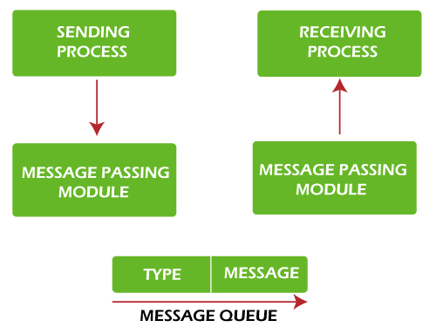
IPC using Message Queues
A message queue is a linked list of messages stored within the kernel and identified by a message queue identifier. Below are the following steps to perform communication using message queues

Slide 13
A new queue is created or an existing queue opened by msgget().
New messages are added to the end of a queue by msgsnd(). Every message has a positive long integer type field, a non-negative length, and the actual data bytes (corresponding to the length), all specified to msgsnd() when the message is added to a queue.
Messages are fetched from a queue by msgrcv(). We don't have to fetch the messages in a first-in, first-out order. Instead, we can fetch messages based on their type field. All processes can exchange information through access to a common system message queue. The sending process places a message onto a queue that another process can read. Each message is given an identification or type so that processes can select the appropriate message. The process must share a common key to gain access to the queue in the first place.
Perform control operations on the message queue msgctl().
Program 1: Let's write a program for IPC using Message Queues to send data to a message queue.
#include<stdlib.h>
#include<stdio.h>
#include<string.h>
#include<unistd.h>
#include<sys/types.h>
#include<sys/ipc.h>
#include<sys/msg.h>
#define MAX_TEXT 512 //maximum length of the message that can be sent allowed

Slide 14
struct my_msg{
long int msg_type;
char some_text[MAX_TEXT];
};
int main()
{
int running=1;
int msgid;
struct my_msg some_data;
char buffer[50]; //array to store user input
msgid=msgget((key_t)14534,0666|IPC_CREAT);
if (msgid == -1) // -1 means the message queue is not created
{
printf("Error in creating queue\n");
exit(0);
}

Slide 15
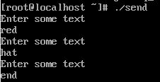
while(running)
{
printf("Enter some text:\n");
fgets(buffer,50,stdin);
some_data.msg_type=1;
strcpy(some_data.some_text,buffer);
if(msgsnd(msgid,(void *)&some_data, MAX_TEXT,0)==-1) // msgsnd returns -1 if the message is not sent
{
printf("Msg not sent\n");
}
if(strncmp(buffer,"end",3)==0)
{
running=0;
}
}
}

Slide 16
Now, let's write a program for IPC using Message Queues to receive or read message from the above created message queue.
#include<stdlib.h>
#include<stdio.h>
#include<string.h>
#include<unistd.h>
#include<sys/types.h>
#include<sys/ipc.h>
#include<sys/msg.h>
struct my_msg{
long int msg_type;
char some_text[BUFSIZ];
};
int main()
{
int running=1;
int msgid;
struct my_msg some_data;
long int msg_to_rec=0;
msgid=msgget((key_t)12345,0666|IPC_CREAT);
the following output.

Slide 17
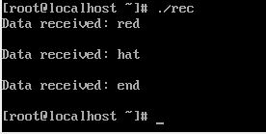
while(running)
{
msgrcv(msgid,(void *)&some_data,BUFSIZ,msg_to_rec,0);
printf("Data received: %s\n",some_data.some_text);
if(strncmp(some_data.some_text,"end",3)==0)
{
running=0;
}
}
msgctl(msgid,IPC_RMID,0);
}
Output
The above code gives

